Slide 1
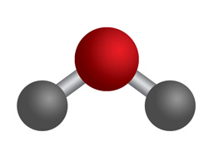
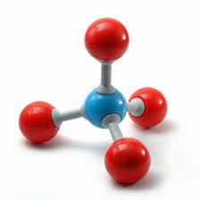
Lecture 11. Polyatomic Molecules

Slide 2
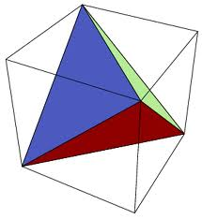
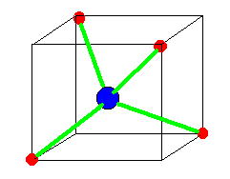
Hybridization of s & three p orbitals (sp³):
Tetrahedral geometry
Contributions from s = 25%; p=75%
There is no unique combination/solution
(depends on the orientation!)

Slide 3
Angles between two hybrid orbitals

Slide 4
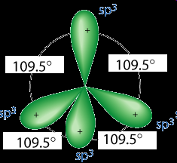
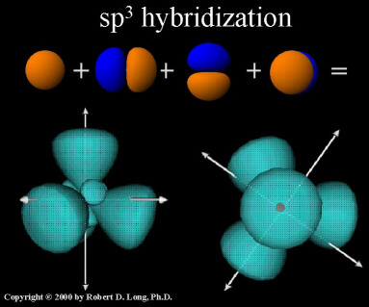
What if h1 is oriented along z-axis?
Tutorial problem

Slide 5
What if h1 is oriented along z-axis?
Tutorial problem

Slide 6
What if h1 is oriented along z-axis?
Tutorial problem

Slide 7
What if h1 is oriented along z-axis?
Tutorial problem

Slide 8
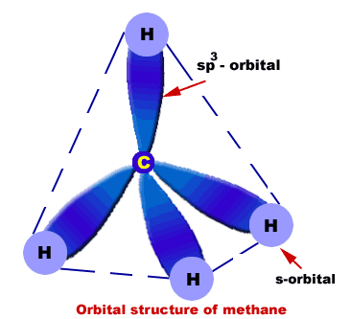
What if h1 is oriented along z-axis?
Tutorial problem

Slide 9
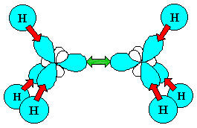
What if h1 is oriented along z-axis?
Tutorial problem

Slide 10
Bond angles
Tutorial problem
angle between two vectors

Slide 11
Bond angles
Tutorial problem

Slide 12
Non-equivalent Hybrid Orbitals: H₂O
H_{b}
+z
H_{a}
H—O—H angle (2θ = 104.5º)
θ
θ
2 H atoms along +z, in yz plane
2 Lone pair of electrons in xz plane (-z)
+y
Why take a negative sign of coefficient for 2s?
In order to get a “+” sign on the
major lobe of each hybrid orbital,
which have to form MO with 1s
orbital of H (with + sign)

Slide 13
Coefficients of 2 Hybrid Orbitals involved in bonding with H(1s)
Orthogonality:
H_{b}
+z
H_{a}
θ
θ
+y

Slide 14
Coefficients of 2 Hybrid Orbitals involved in bonding with H(1s)
Orthogonality:
H_{b}
+z
H_{a}
θ
θ
+y

Slide 15
Normalize each bonding hybrid orbital to obtain correct coefficients
% p character: (0.55)²+(0.71)²=0.80 (80%)
% s character = (-0.45)² = 0.2 (20%)
➔ more like sp⁴ , rather than sp³

Slide 16
Lone-pair hybrid orbitals have different coefficients!
H_{a}
+z
d₂=d₆=0
+x
H_{b}
LP₁
Θ
Θ
H_{b} behind H_{a}
+y
+z
Φ
-z
H_{a}
H_{b}
2 Lone pair hybrids along negative z axis and in xz plane – No contribution from p_{y}
2p_{y}→0
LP₂
-x
LPs

Slide 17
Lone-pair hybrid orbitals have different coefficients!
d₂=d₆=0
+x
LP₁
H_{b} behind H_{a}
+z
Φ
-z
H_{a}
H_{b}
LP₂
-x

Slide 18
Lone-pair hybrid orbitals have different coefficients!
s : Same for both LP hybrid orbitals: d₃ = d₇
2p_{z} : Same for both LP hybrids: d₅ = d₁
2p_{x}: Same magnitude, opposite in sign: d₈ = -d₄
d₂=d₆=0
+x
LP₁
H_{b} behind H_{a}
+z
Φ
-z
H_{a}
H_{b}
LP₂
-x

Slide 19
Total contribution of s, p_{x}, p_{y}, p_{z} is unity considering all four hybrids
For lone-pair
hybrid orbitals:
For bonded
hybrid orbitals:
For 2p_{z}
For 2p_{y}
For 2s
For 2p_{x}

Slide 20
Different s-/p- character for the two classes of hybrids in H₂O
H_{b}
+z
H_{a}
+x
LP₁
Θ
Θ
+z
Φ
-z
+y
H_{a}
H_{b}
LP₁
LP₂
LP₂
-x
s➔(0.55)²→30%
p➔100-30→70%
s➔ 20%
p➔ 80%

Slide 21
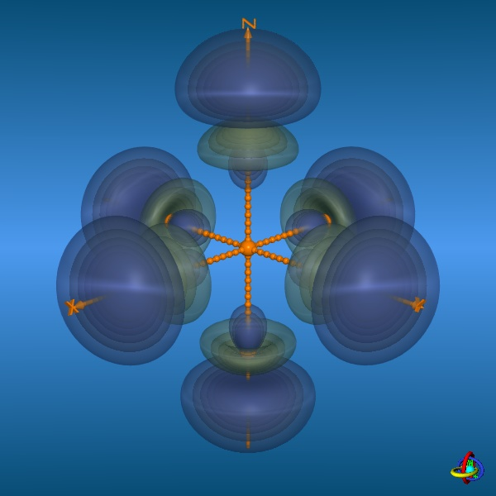
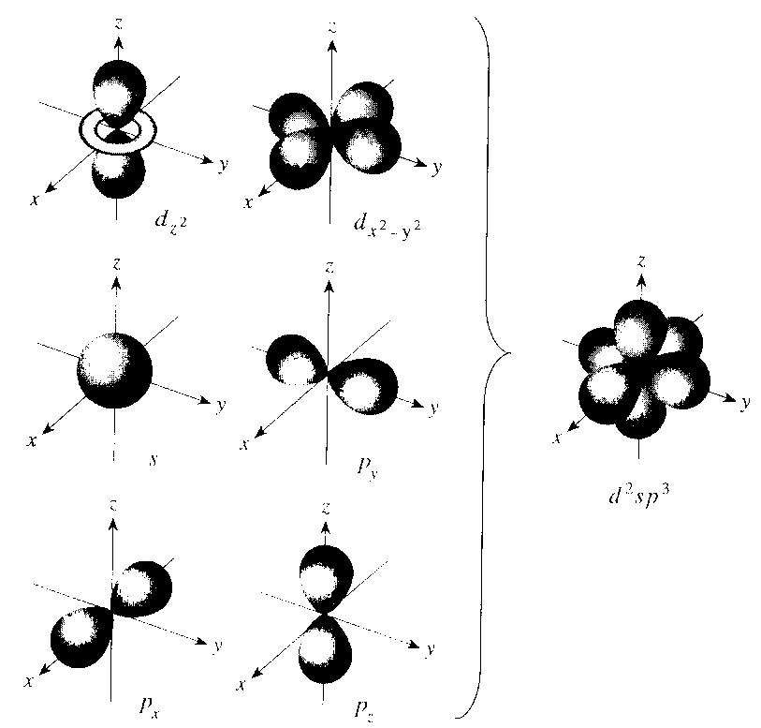
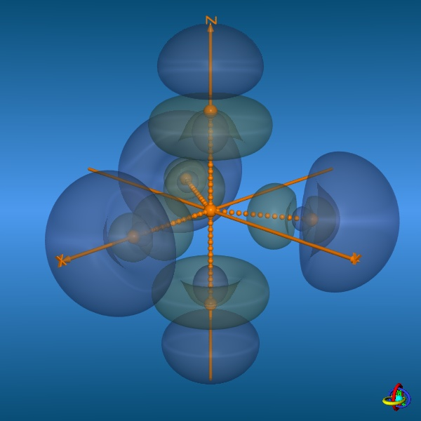
Hybridization of s,p,d: sp³d² and sp³d
sp³d²: octahedral
Similarly, sp³d →
trigonal bipyramidal

Slide 22
Hybridization vs. MOT
Hybridization: Highly directional, localized bonds
MOT: Delocalized MOs
Do they agree?
Does MOT provide some extra information?

Slide 23
Methane: VBT picture with sp₃ orbitals
Contributions from s = 25%; p=75%
There is no unique combination/solution
(depends on the orientation!)

Slide 24
Methane: Delocalized MOT picture
AOs with proper symmetry can only be combined
Central Carbon atom: 2s and 2p orbitals

Slide 25
Methane: Delocalized MOT picture
2s orbital
P
Q
Linear combination of hydrogen
1s orbitals with matching symmetry:
S
R

Slide 26
Methane: Delocalized MOT picture
2p orbital
P
Q
Linear combination of hydrogen
1s orbitals with matching symmetry:
3 such linear combinations:
x, y, z
S
R

Slide 27
Methane: Delocalized MOT picture
Two kinds of Molecular Orbitals
1 MO, no node
3 MOs, one node in each
Same energy?
Experimental evidence?

Slide 28
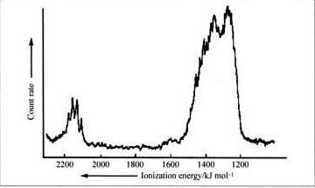
Methane: Energy Diagram and Photoelectron spectrum
C H
2p
4 × 1s
2s
2 kinds of MOs: 2 energy levels
Bond lengths: equal
All MOs contribute equally to each bond
VB and MO pictures correlated
Properties depend on the experiment
http://bilbo.chm.uri.edu/CHM401/fall2008exam1-4.html

